Slide 1

Immersion Day – Big Data

Slide 2
Why Real-Time Processing?

Slide 3
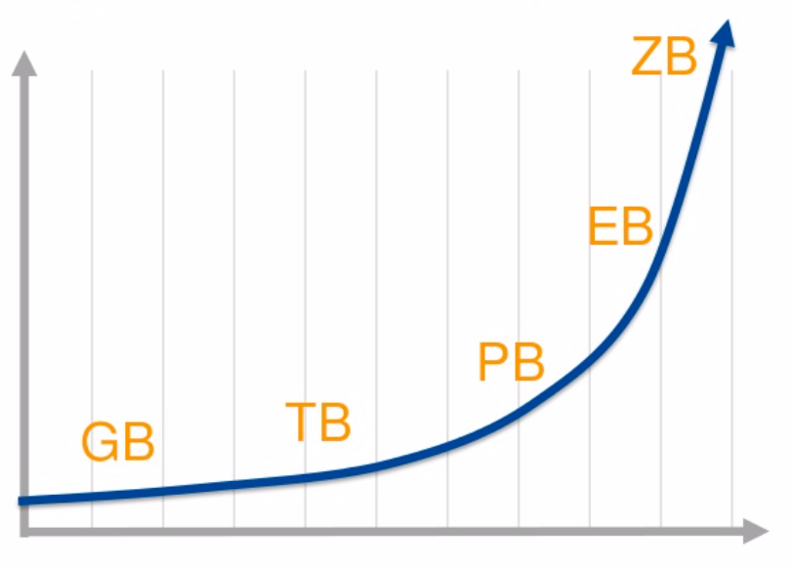

Slide 4
IT/Application servers logs
IT Infrastructure logs, Metering,
Audit logs, Change logs

Slide 5
IT/Application servers logs
IT Infrastructure logs, Metering,
Audit logs, Change logs
Web sites / Mobile Apps / Ads
Clickstream, User Engagement

Slide 6
IT/Application servers logs
IT Infrastructure logs, Metering,
Audit logs, Change logs
Web sites / Mobile Apps / Ads
Clickstream, User Engagement
Sensor Data
Weather, Smart Grids, Wearables

Slide 7
IT/Application servers logs
IT Infrastructure logs, Metering,
Audit logs, Change logs,
Web sites / Mobile Apps / Ads
Clickstream, User Engagement
Sensor Data
Weather, Smart Grids, Wearables
Social Media, User Content
450MM+ Tweets/day

Slide 8
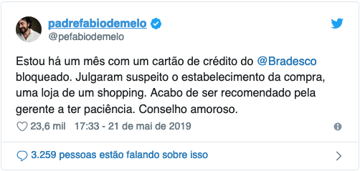

Slide 9


Slide 10
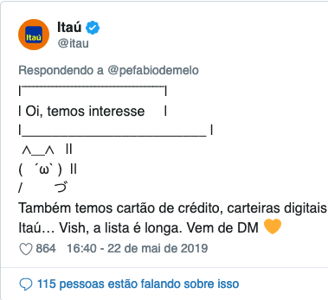

Slide 11
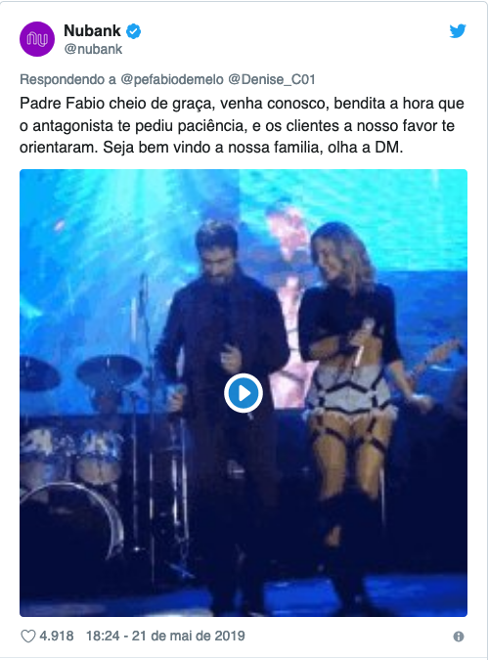

Slide 12


Slide 13

What Big Data gives you??

Slide 14
What Big Data gives you??
Hourly server logs: how your systems were misbehaving an hour ago
CloudWatch metrics: what just went wrong now

Slide 15
What Big Data gives you??
Hourly server logs: how your systems were misbehaving an hour ago
Weekly / Monthly Bill: what you spend this past billing cycle?
CloudWatch metrics: what just went wrong now
Real-time spending alerts/caps: guaranteeing you can't overspend

Slide 16
What Big Data gives you??
Hourly server logs: how your systems were misbehaving an hour ago
Weekly / Monthly Bill: what you spend this past billing cycle?
Daily customer-preferences report from your website's click stream: tells you what deal or ad to try next time
CloudWatch metrics: what just went wrong now
Real-time spending alerts/caps: guaranteeing you can't overspend
Real-time analysis: tells you what to offer the current customer now

Slide 17
What Big Data gives you??
Hourly server logs: how your systems were misbehaving an hour ago
Weekly / Monthly Bill: what you spend this past billing cycle?
Daily customer-preferences report from your website's click stream: tells you what deal or ad to try next time
Daily fraud reports: tells you if there was fraud yesterday
CloudWatch metrics: what just went wrong now
Real-time spending alerts/caps: guaranteeing you can't overspend
Real-time analysis: tells you what to offer the current customer now
Real-time detection: blocks fraudulent use now

Slide 18
What Big Data gives you??
Hourly server logs: how your systems were misbehaving an hour ago
Weekly / Monthly Bill: what you spend this past billing cycle?
Daily customer-preferences report from your website's click stream: tells you what deal or ad to try next time
Daily fraud reports: tells you if there was fraud yesterday
Daily business reports: tells me how customers used AWS services yesterday
CloudWatch metrics: what just went wrong now
Real-time spending alerts/caps: guaranteeing you can't overspend
Real-time analysis: tells you what to offer the current customer now
Real-time detection: blocks fraudulent use now
Fast ETL into Amazon Redshift: how are customers using AWS services now

Slide 19













Analytics
Amazon EMR
Amazon CloudSearch
Amazon CloudSearch
Amazon EMR
Amazon Kinesis
Data Analytics
Amazon Simple Storage Service (S3)
Amazon Kinesis
Amazon Glue
Amazon Athena
Amazon QuickSight
AWS Lake Formation
Amazon Kinesis
Data Streams
AWS Data Pipeline
Amazon Elasticsearch Service
Amazon Managed Streaming for Kafka

Slide 20
Amazon Simple Storage Service (S3)
Amazon Kinesis
Amazon Glue
Amazon Athena
Amazon QuickSight

Slide 21

Introducing Amazon S3
Secure, durable and highly-scalable object storage

Slide 22
What is S3?
S3 Stands for Simple Storage Service
Secure, durable, highly-scalable object storage
Accessible via a simple web services interface, api or cli
Storage & retrieve any amount of data
Use alone or together with other AWS services
Allows unlimited storage of objects (files) containing of 1 byte to 5 gigabytes each.
Objects consist of the raw object data and metadata.
Objects can be made available to public by the http or bittorrent protocol.

Slide 23
What is S3?
Object versioning
Cross Region Replication
Lifecycle Management
Static Web Site Hosting

Slide 24
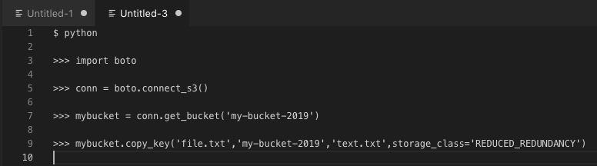
Moving Objects between storage classes

Slide 25
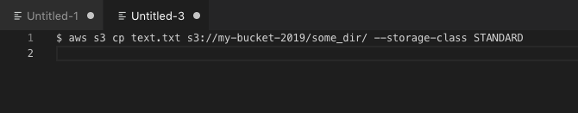
Copying files with awscli

Slide 26
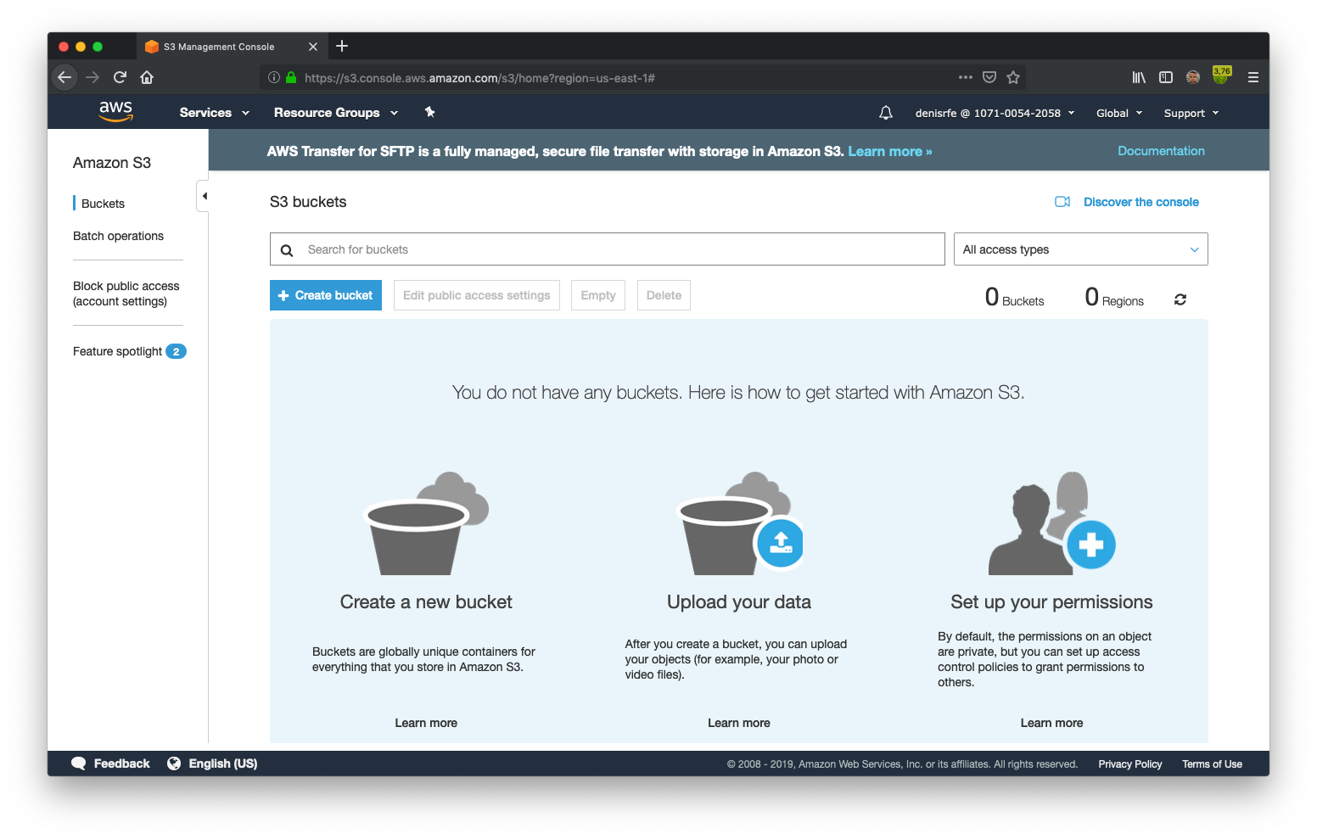
Managing s3 through browser

Slide 27
Introducing Amazon Kinesis
Managed Service for Real Time Processing of Big Data

Slide 28
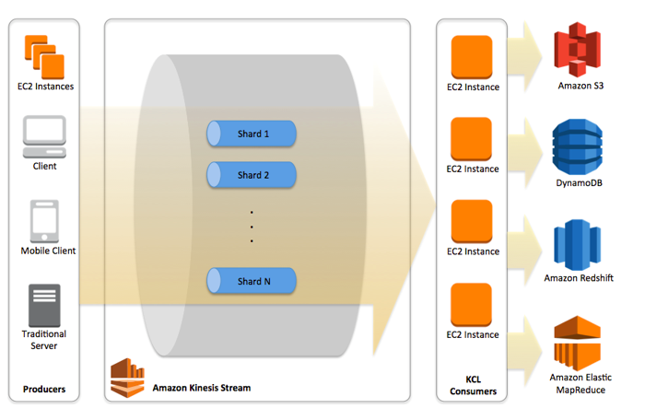
Amazon Kinesis

Slide 29
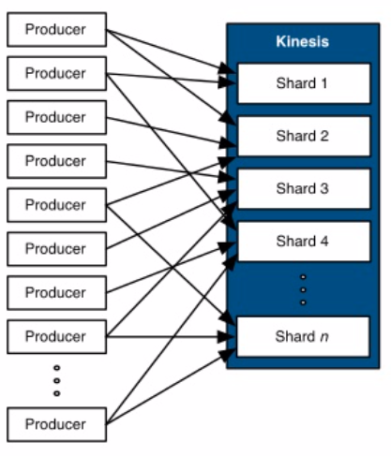
Putting data into Kinesis
Managed Service for Ingesting Fast Moving Data
Streams are made of Shards
A Kinesis Streams is composed of multiple Shards
Each Shard ingests up to 1 MB/sec
All data is stored for 24 hours
You scale Kinesis streams by adding or removing Shards
Simple PUT interface to store data in Kinesis
Producers use a PUT call to store data in a Stream
A Partition Key is used to distribute the PUT across Shards
A unique Sequence number is returned to the Producer upon a successfull PUT call

Slide 30
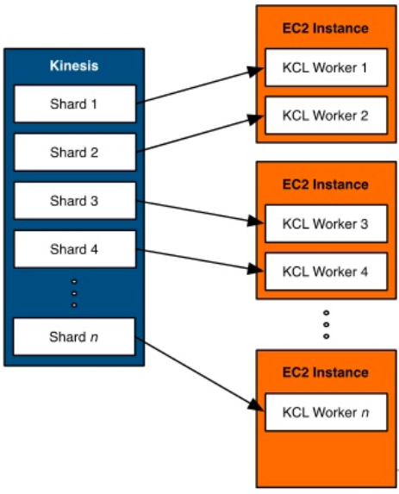
Getting data out of Kinesis
Client library for fault-tolerant, at least-once, real-time processing
In Order to keep up with the stream, your application must:
Be distributed, to handle multiple shards
Be fault tolerant, to handle failures in hardware or software
Scale up and down as the number of shards increase or decrease
Kinesis Client Library (KCL) helps with distributed processing:
Simplifies reading from the stream by abstracting your code from individual shards
Automatically starts a Kinesis Worker for each shard
Increase and decrease Kinesis Workers as number of shards changes
Uses checkpoints to keep track of a Worker's location in the stream
Restarts Workers if they fail

Slide 31
Getting data out of Kinesis
Client library for fault-tolerant, at least-once, real-time processing
Use the KCL with Auto Scaling Groups:
Auto Scaling policies will restart EC2 instances if they fail
Automatically add EC2 instances when load increases
KCL will automatically redistribute Workers to use the new EC2 instances

Slide 32
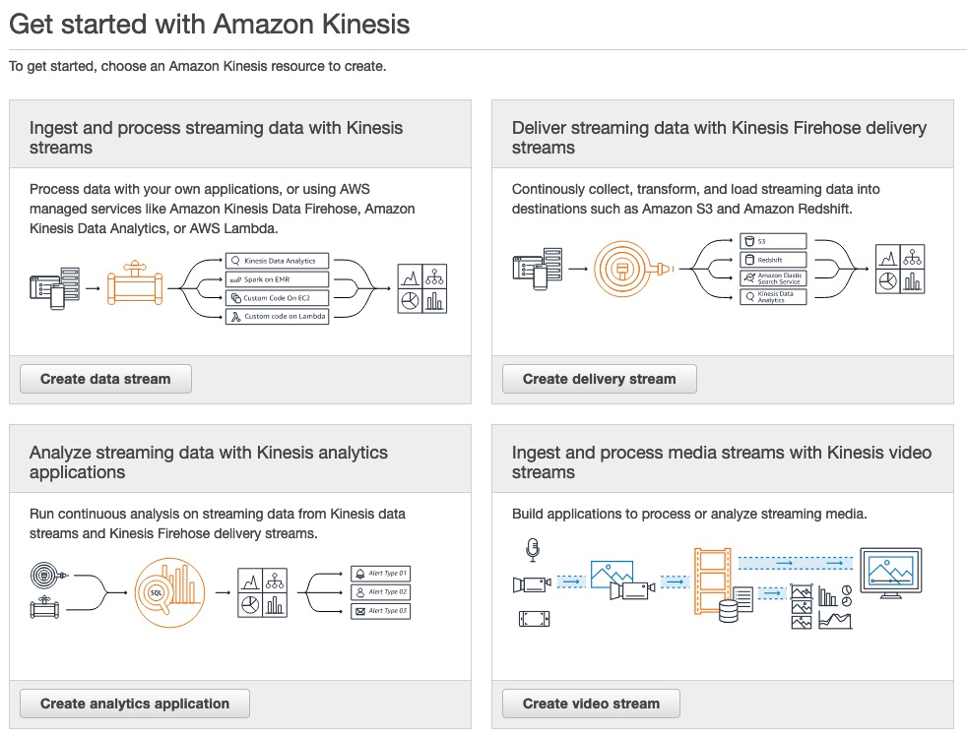

Slide 33
Introducing Amazon Glue
Fully managed ETL service

Slide 34
Simple, flexible, cost-effective ETL
AWS Glue is a fully managed ETL (extract, transform and load) service
Categorize your data, clean it, enrich it and move it reliably between various data stores
Once catalogued, your data is immediately searchable and queryable
Simple and cost-effective
Serverless, runs on a fully managed, auto-scaling Spark environment

Slide 35
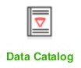
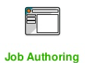
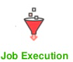
AWS Glue Components
Discover and Organize your data in various
databases, data warehouses and data lakes
Focus on the writing transformations
Generate code through a wizard
Write your own code
Runs jobs in Spark containers - automatic scaling based on SLA
Glue is serverless - only pay for the resources you consume

Slide 36

Crawlers, auto-populate data catalog
Run crawlers on-demand and on a schedule to discover new data and schema changes
Serverless - Only pay when crawls run
Crawlers can crawl both file-based and table-based data stores

Slide 37
Which Data Stores Can I Crawl?
Crawlers can crawl the following data stores through their respective native interfaces:
Amazon Simple Storage Service (Amazon S3)
Amazon DynamoDB

Slide 38
Which Data Stores Can I Crawl?
Crawlers can crawl the following data stores through a JDBC connection:
Amazon Redshift
Amazon Relational Database Service (Amazon RDS)
Amazon Aurora
MariaDB
Microsoft SQL Server
MySQL
Oracle
PostgreSQL

Slide 39
Which Data Stores Can I Crawl?
Crawlers can crawl the following data stores through a JDBC connection:
Publicly accessible databases
Amazon Aurora
MariaDB
Microsoft SQL Server
MySQL
Oracle
PostgreSQL

Slide 40
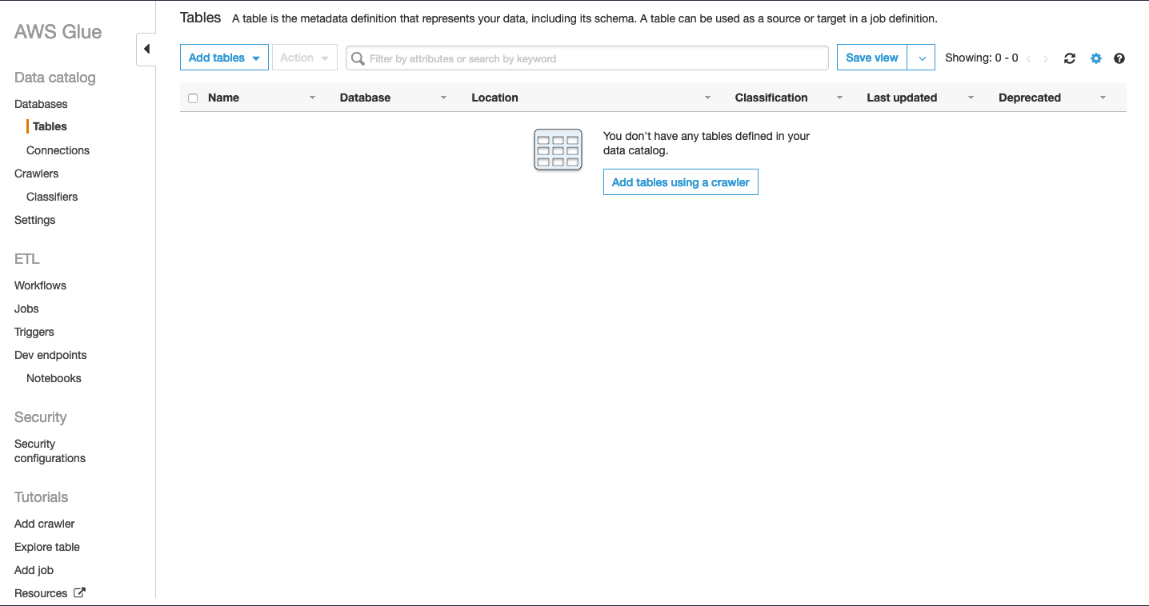

Slide 41
Introducing Amazon Athena
Interactive data analysis tool for complex queries

Slide 42
What is Amazon Athena?
Amazon Athena is an interactive query service that makes it easy to analyze data in Amazon S3 using standard SQL.
Athena is serverless, so there is no infrastructure to manage,it scales with usage, is high available and fault tolerant, and you pay only for the queries that you run.

Slide 43
Benefits
Easy to Use
Log into the Console
Create a table
Type in a Hive DDL Statement
Use a Glue Data Catalog
Use the Console Add Table wizard
Start querying

Slide 44
Benefits
High Available
You connect to a service endpoint or log into the console
Athena uses warm compute pools across multiple Availability Zones
Your data is in Amazon S3, which is also highly available and designed for 99.999999999% durability

Slide 45
Benefits
Simple Pricing
DDL operations - FREE
SQL operations - FREE
Data scanned - $5 / TB
Standard S3 rates for storage requests, and data transfer apply

Slide 46
Amazon Athena
Suported Data Formats
CSV, TSV, JSON or Textfiles
ORC
Parquet
Snappy
Zlib
LZO
GZIP

Slide 47
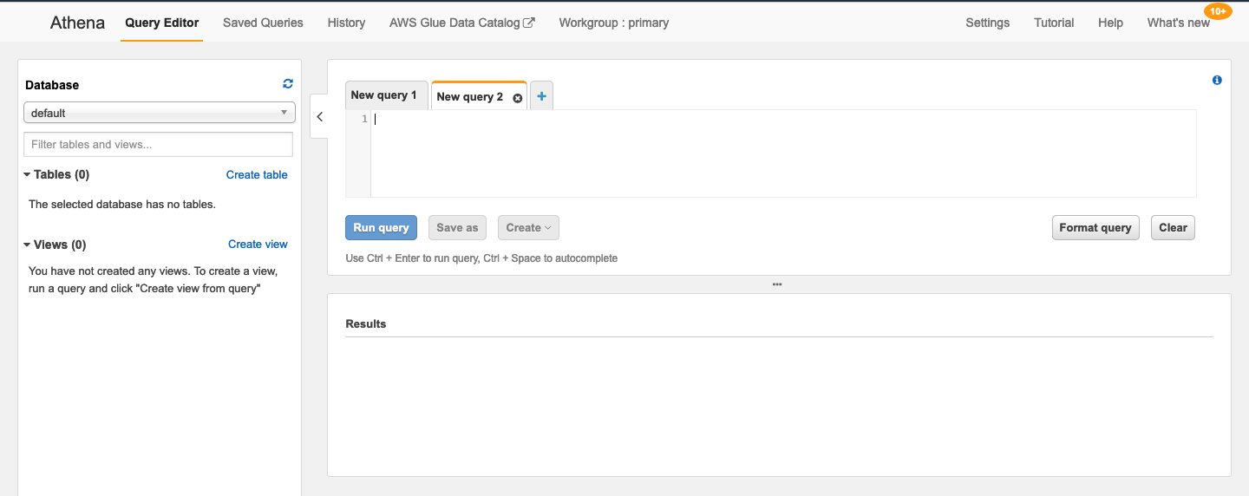

Slide 48
Introducing Quicksight
Fast, cloud-powered business intelligence service

Slide 49
What is Amazon QuickSight?
Amazon Athena is an interactive query service that makes it easy to analyze data in Amazon S3 using standard SQL.
Athena is serverless, so there is no infrastructure to manage, it scales with usage, is high available and fault tolerant, and you pay only for the queries that you run.

Slide 50
Who Is QuickSight For?
QuickSight is designed to give everyday business users the flexibility to do easy, self-serve analysis on their data.
QuickSight is also perfect for delivering published dashboards throughout the organization.

Slide 51
Deep Integration with AWS Data Sources
QuickSight is deeply integrated with AWS data sources like:

Slide 52

Deep Integration with AWS Data Sources
QuickSight is deeply integrated with AWS data sources like:
Amazon Redshift

Slide 53

Deep Integration with AWS Data Sources
QuickSight is deeply integrated with AWS data sources like:
Amazon Redshift
Amazon RDS

Slide 54
Deep Integration with AWS Data Sources
QuickSight is deeply integrated with AWS data sources like:
Amazon Redshift
Amazon RDS
Amazon Simple Storage Service

Slide 55

Deep Integration with AWS Data Sources
QuickSight is deeply integrated with AWS data sources like:
Amazon Redshift
Amazon RDS
Amazon Simple Storage Service
Amazon Athena

Slide 56
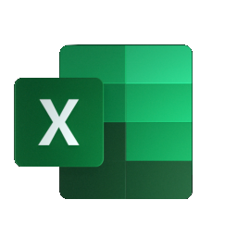
Deep Integration with AWS Data Sources
QuickSight is deeply integrated with AWS data sources like:
Amazon Redshift
Amazon RDS
Amazon Simple Storage Service
Amazon Athena
Microsoft Excel

Slide 57

Deep Integration with AWS Data Sources
QuickSight is deeply integrated with AWS data sources like:
Amazon Redshift
Amazon RDS
Amazon Simple Storage Service
Amazon Athena
Microsoft Excel
Salesforce

Slide 58
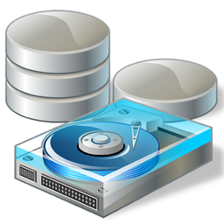
Deep Integration with AWS Data Sources
QuickSight is deeply integrated with AWS data sources like:
Amazon Redshift
Amazon RDS
Amazon Simple Storage Service
Amazon Athena
Microsoft Excel
Salesforce
On-Premises Database

Slide 59
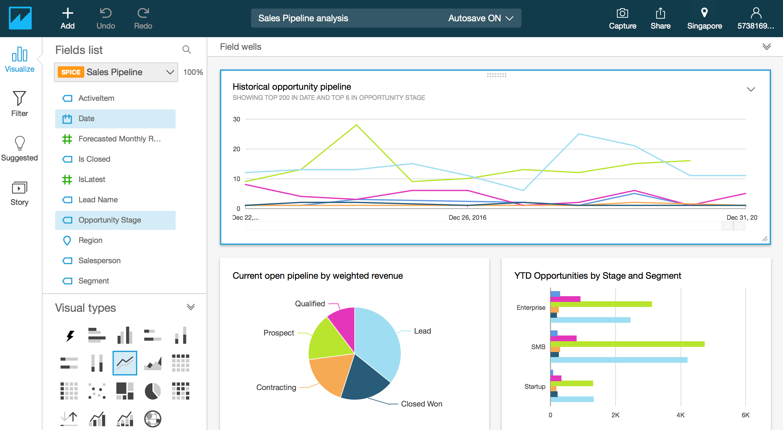

Slide 60
QUESTIONS?

Slide 61

HANDS ON

Slide 62
Obrigado!
https://gitlab.com/denisrfe/immersionday.git

